Slide 1

BANGALORE INSTITUTE OF TECHNOLOGY
K.R.Road, V.V.Puram, Bengaluru-560004
INFORMATION SCIENCE AND ENGINEERING
MOBILE APPLICATION DEVELOPMENT(18CSMP68)
MINI PROJECT
ON
“MUSIC PLAYER APP”
Submitted By:
Rohan R N -1BI18IS039
Sagar M N -1BI18IS042
Sathvik D N -1BI18IS046

Slide 2
INTRODUCTION
Music is a vital part of daily living, as Albert Einstein stated, “life without playing music would be inconceivable”. There is no one living in this earth who does not listen to any kind of music.
The Music player is an application which will let the user to listen to their favorite songs. The user can switch and pause tracks with a simple touch.
There are many types of music which can be played including popular music, traditional music, art music, and music written for religious ceremonies.
Music can be divided into genres such as country music, rock music, pop, classical,hiphop which will be helpful for the user to find the perfect song.

Slide 3
PROPOSED SYSTEM
Splash screen: Pops up when the application is opened.
Home screen: shows all the songs present in the phone.
Music card: Displays which song is being played.
Settings: It will contains about
Like: Liking the song results in adding the song to favorites. You can delete
song from favorites too.
Forward option: For playing the next song.
Previous option: For playing the previous song.

Slide 4
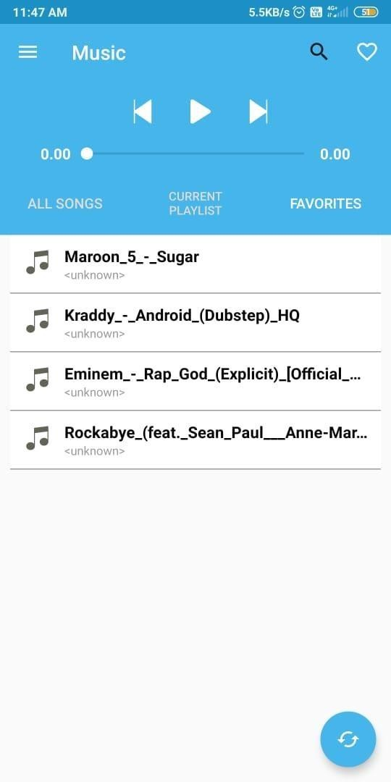
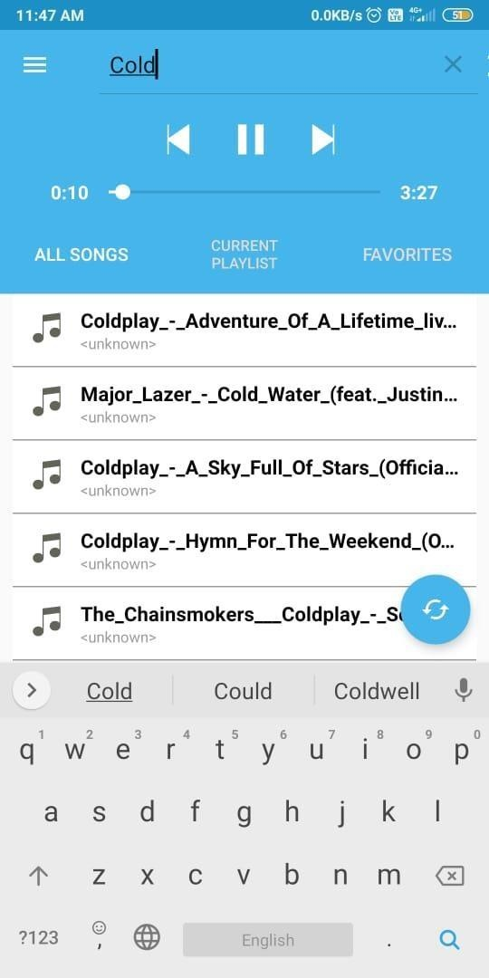
.
.

Slide 5
HOW THE MUSIC APP MIGHT HELP OUR SOCIETY
There are many things in music, to which one can listen and bring attention.
Music can stimulate the mind
Music can raise someone's mood, get them excited, or make them calm and relaxed.
Music also allows us to feel nearly or possibly all emotions that we experience in our lives.

Slide 6
NEGATIVE EFFECTS OF MUSIC :
Research suggests music can influence us a lot. It can impact illness, depression, spending, productivity and our perception of the world.
Some research has suggested that it can increase aggressive thoughts, or encourage crime.

Slide 7
FEASIBILITY STUDY:
A feasibility study is conducted to select the best system that meets the requirement. The key considerations in feasibility analysis are:
Economic feasibility
Technical feasibility
Operational feasibility

Slide 8
THANK YOU

